Slide 1
June 16, 2016
V. 2

Slide 2
AGENDA
Welcome - Steven Glyer
CTE Spotlight Awards/NACCE - Alex Davis
$200M Update - Steven Glyer
Data Unlocked Update - Nick Kremer
DOW - Nick Kremer
CTE EF Reallocation - Janeth Manjarrez
Marketing Workgroup - Paul De La Cerda
Chancellor’s Report - Robin Harrington
Announcements

Slide 3
CTE Spotlight Awards/NACCE - Alex Davis
See Alex PowerPoint

Slide 4
$200M SWP Update - Steven Glyer
Was the budget approved? YES by Legislature
Key points on the final Trailer Bill:
Split is 60% Local/40% Regional
One time removed, now ongoing
SB1070 will be rolled into SWP
Cap removed on Local Share - on-going OK

Slide 5
Planning - Steven Glyer
Trailer Bill states that each regional consortia needs to have a plan in place by January 31, 2016 to receive any of the $200M.
Chancellor’s Office webinar for LAOCRC
Thursday, June 3 from 2:00 - 3:00 pm.
CC Confer - 888-886-3951 --- Code: 4628215
Planning Workgroup - call for volunteers

Slide 6
CTE Leadership Summit - Steven Glyer
Community College League of California
Advancing CEO Leadership in CTE -
Now open to CIOs and CTE Deans
Friday Aug. 5, 2:00 pm - Saturday Aug. 6, 12:30 pm
Waterfront Hotel, Oakland - book by Tue., July 5
LINK to register: http://www.ccleague.org/i4a/pages/index.cfm?pageID=3886

Slide 7
Listening Sessions - Steven Glyer
Los Angeles Region - June 8th
Orange County - June 29th
Coast CCD - Board Room
10:00 am - 12 noon

Slide 8
Listening Sessions - Steven Glyer
1. What are county/college needs that LAOCRC can help you meet?
2. Would a LAOCRC staff person assigned to focus on the county be helpful?
3. What should the qualifications of that person be?
4. What sub-regional initiatives would serve the colleges in meeting county-wide or sub-county needs?

Slide 9
DataUnlocked & DOW - Nick Kremer
See Nick’s PowerPoint

Slide 10
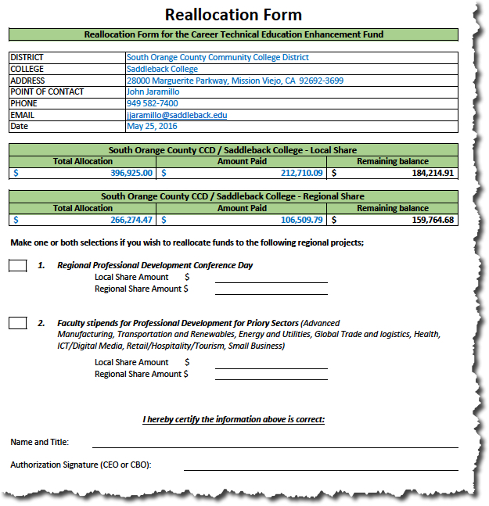
CTE EF Reallocation - Janeth Manjarrez
The Reallocation Form will be for those colleges who will need to reallocate funds to approved projects by CO.
We invite other possible options so please connect with me to discuss.
The form must be signed by your CEO or CBO.
The expenditures will be based on the QR4

Slide 11
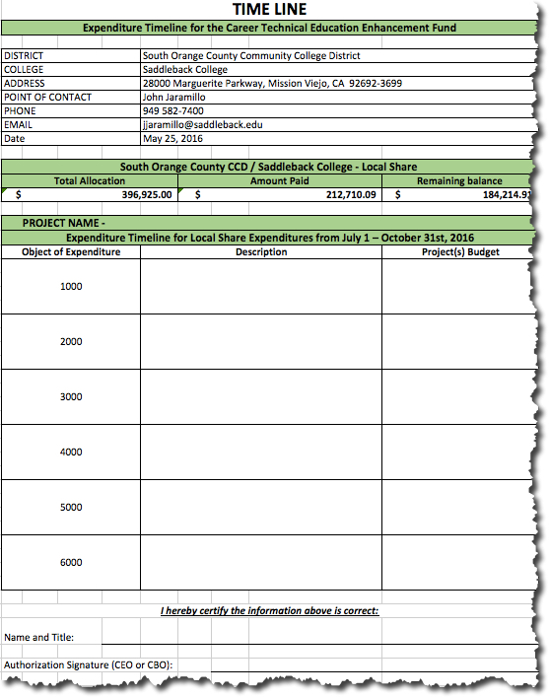
CTE EF Timeline - Janeth Manjarrez
The Expenditure Timeline Form will be for those colleges who will spend all funds by October 31st, 2016 (deadline)
The forms has the object of expenditures to input the allocation of per categorical item
We will also send it to your fiscal office and will require a monthly expenditure report until October
Also requires signature from your CEO or CBO

Slide 12
Chancellor’s Report - Robin Harrington
Perkins IV/V
 2017-18 Funding (level funded) -- Appropriations Link Below
http://www.appropriations.senate.gov/imo/media/doc/060916-FY17-LaborHHS-Approps-Full-Committee-Markup-Summary-Web.pdf
 Republican Blueprint for a Wide Range of Issues Including CTE/Perkins (Link Below)
http://abetterway.speaker.gov/_assets/pdf/ABetterWay-Poverty-PolicyPaper.pdf
 2016-17 Title I-C Allocations Increase (Announcement, Instructions, Allocation Listing)
http://extranet.cccco.edu/Portals/1/WED/Perkins/16-204-2016-17%20Title%20I-C%20Allocation%20Increase_Final.pdf
 Perkins 2015-16 Budget Change Reminder


Slide 13
Chancellor’s Report - Robin Harrington
2016-17 State Budget Update
Eliminate the 60% cap on ongoing expenditures, yet maintains the 60%/40%
SB 1070 CTE Pathways program funds in 2016-17 ($48 million).
SB 1070 CTE Pathways program funding 2017-18
SB1402 program funds in 2016-17 ($22.9 million)
DSN/SN/TAPs/Regional Consortia
For those asking about Deputy Sector Navigators, Sector Navigator and Regional Consortia positions for the coming fiscal years, the intent of the system Office is to continue the current structure and the allocation of funding to sustain it.



Slide 14
Chancellor’s Report - Robin Harrington
Adult Education Block Grant (AEBG)
Student Data Instructions have been released for fiscal year 2015-16
http://aebg.cccco.edu/Portals/1/docs/reporting/5.26.16%20AEBG_1516%20Student%20Data%20Collection.pdf
The 2016-17 preliminary allocation schedule was posted in February 2016 (links to intent to award and preliminary allocation) :
1. Intent to Award Letter
2. Preliminary Allocation Schedule
Webinar – overview of the data and accountability instructions
http://aebg.cccco.edu/Events/AEBG-Webinar-Series



Slide 15
Announcements
Orange County Listening Session - June 29, 2016 - Coast District Board Room, 10:00 am - 12 noon
CTE Leadership Summit: Aug. 5-6, Oakland
CEO Summit #2: September 15, 2016 - Cerritos Sheraton
Orange County OC3 - Mary Anstadt - Today - Next

Slide 16
Until Next Time …………...
September 2017 Program Approval Cycle
Apps Due - Aug. 30, 2016
Voting Window - Sept. 9th - 16th
PA Meeting - Sept. 15, 8:30 - 9:30
September Consortia Meeting
Wednesday, Sept. 28, 2016
Time: TBD
Fall CCCAOE Conference
Sept 27-29, 2016
Omni Rancho Las Palmas Hotel
Rancho Mirage

